Slide 1
DOM Advanced

Slide 2
Fetch
In older JS we are using XMLHttpRequest object which provides a more powerful and flexible way to handle HTTP requests.
Those callings are called as an AJAX Calls.
In modern JS it was replaced by Fetch() method
The fetch() function is used to make network requests and retrieve resources from a server.

Slide 3
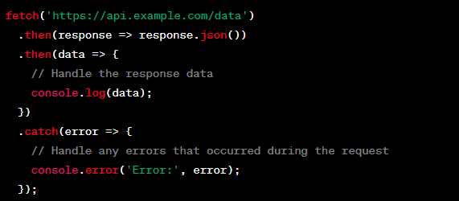
How to work with Fetch?

Slide 4
API calls
Whenever we are creating any server we can handle the different request
Like GET, POST, PUT, DELETE and PATCH
Using that we can do different operations like
Get ALL DATA
Get BY ID
ADD NEW DATA
Update Data
Delete Data By Id

Slide 5
For that Let’s create One JSON Server
install JSON Server by using below command
npm install json-server –g
Once it is installed Let’s create one file using the same.
json-server data.json
We can edit this file and let’s restart the server and check all methods.
For checking this method we will use POSTMAN tool
Let’s check ALL CRUD operation with that file.

Slide 6
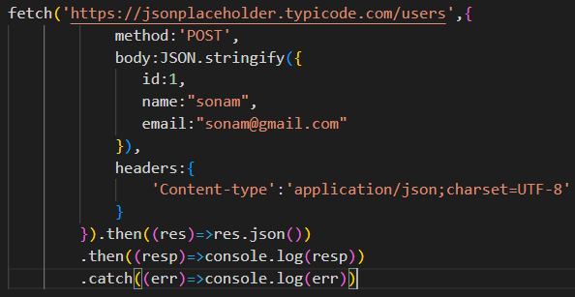
Store Data using Fetch POST Method

Slide 7
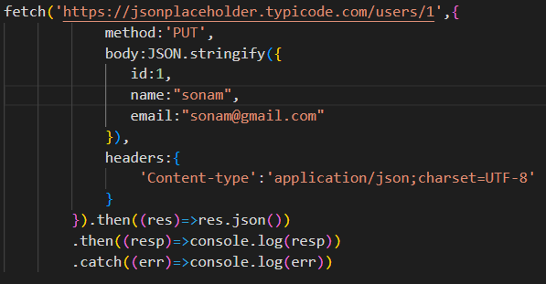
Update Data using Fetch PUT Method

Slide 8
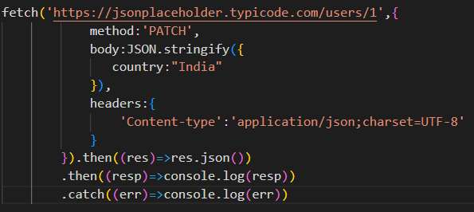
Patch Some Data using PATCH Method

Slide 9
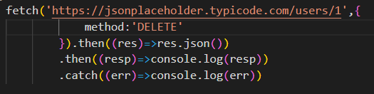
Delete User

Slide 10
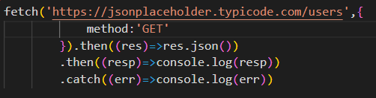
Get All User

Slide 11
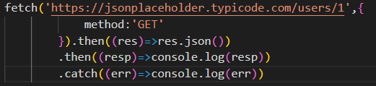
Get By Id

Slide 12
Event loop
event loop operates within the JavaScript runtime environment like
browser
Node.js
Which consists of two main components:
the call stack
task queue (also known as the event queue).

Slide 13
Call Stack
It keeps track of all the running functions
Follows LIFO order
Executes things step by step
Keeps track of all point like when the task completes it returns its control back

Slide 14
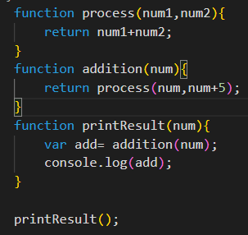
Call Stack
Stack
Execution
process()
Addition()
printResult()
Main()

Slide 15
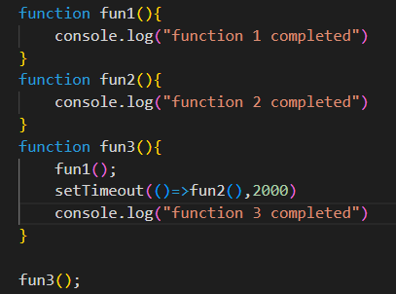

CallBack Queue
Output

Slide 16
CallBack Queue
The task queue holds tasks that are ready to be processed by the event loop.
These tasks include events like user interactions (e.g., clicks), timers (e.g., setTimeout), and network responses (e.g., fetch requests).
Each task in the queue is associated with a callback function that will be executed when the task is processed.
Call stack is give priority, everything is the callstack executed then it will check callback queue to execute the callback functions.

Slide 17
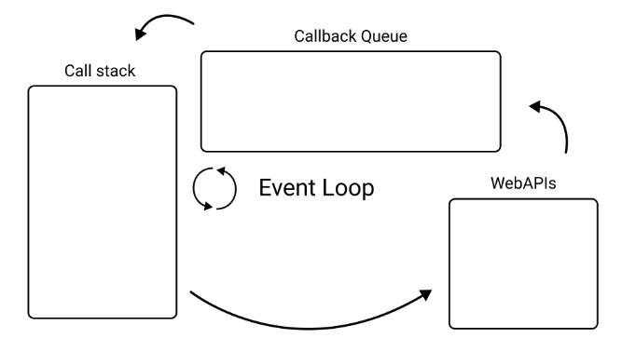
Event Loop
Event loop is doing a simple Job of monitoring call stack and callback queue.
If the stack is Empty event loop will take the first event from the queue and push it to the stack for execution.
It works like a scheduler like what to execute now and later.

Slide 18
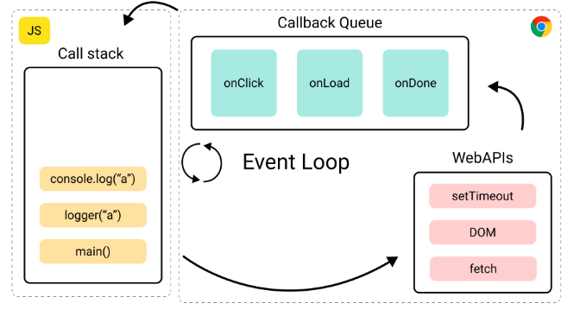

Slide 19
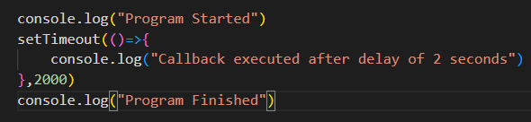
Let’s understand the same with one program

Slide 20
Event Delegation
Event delegation is a technique in JavaScript where you attach an event listener to a parent element instead of individual child elements.
Benefits:
handle events for multiple elements using a single event listener
reducing the number of event handlers
improving performance
Generate dynamic handlers for large sets of elements.

Slide 21
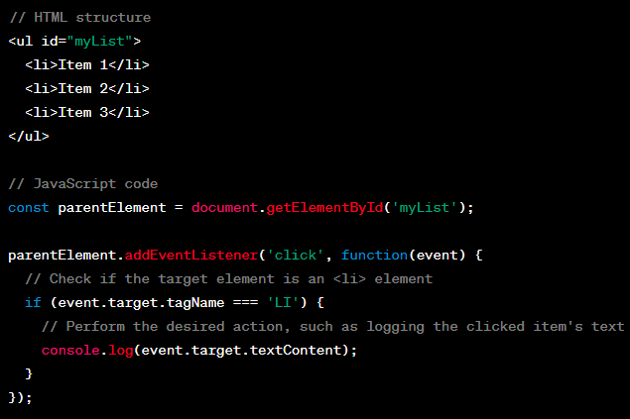
Let’s understand

Slide 22
Browser Storage
Browser Storage
Local Storage
Session Storage

Slide 23
Local Storage
The localStorage object allows you to store key-value pairs persistently in the browser.
The data stored in localStorage remains even after the browser is closed and reopened.
You can access stored data using the localStorage object.
It localStorage store data as strings.
If you need to store complex objects, you can use JSON.stringify() to convert them to a string before storing and JSON.parse() to convert them back to objects when retrieving.

Slide 24
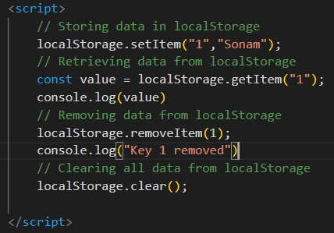
Let’s use It

Slide 25
Session Storage
The sessionStorage object is similar to localStorage but has a shorter lifespan.
The data stored in sessionStorage is tied to a specific browsing session and is deleted when the session is closed.
The sessionStorage API is similar to localStorage but accessed via the sessionStorage object.

Slide 26
Usage
User session management
Form data persistence
Remembering user preferences
Caching frequently accessed data
Storing temporary state information

